Slide 1



Slide 2
Quick Recap
Project Goal – Exploring the data to bring out meaningful and useful trends in Chicago crime data and predicting the crime type based on other features of that crime.
Things done in past three deliverables: Data extraction & cleaning, Handling null values, Data wrangling, Feature selection and predicting whether Arrest was made or not were done.

Slide 3
Project Workflow
Raw Data
Data Cleaning
Handling Nulls
Exploratory Data Analysis
Data Pre-processing
Splitting the Data
Training Models to Predict Crime Type [Primary type of Crime]
Assess the results

Slide 4
New improvements in Final Deliverable
In this deliverable I have worked on predicting the Crime Type based on other features of crime like when and where the crime occurred etc.
I used three different models -
1) RandomForestClassifier
2) Multi-layer Perceptron classifier Neural Network
3) KNeighborsClassifier
Finally I included all three models in a voting classifier for better results building voting ensemble model

Slide 5
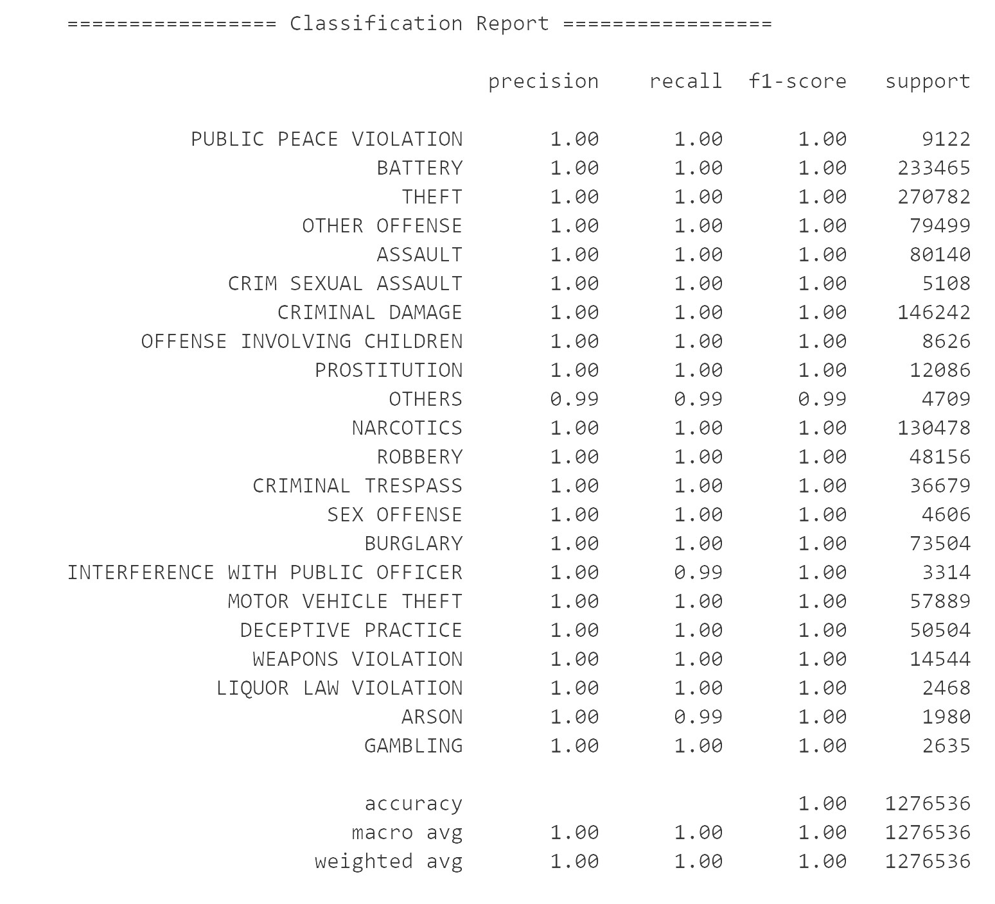
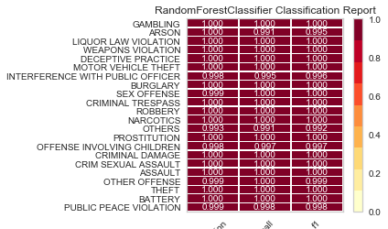
RandomForestClassifier

Slide 6
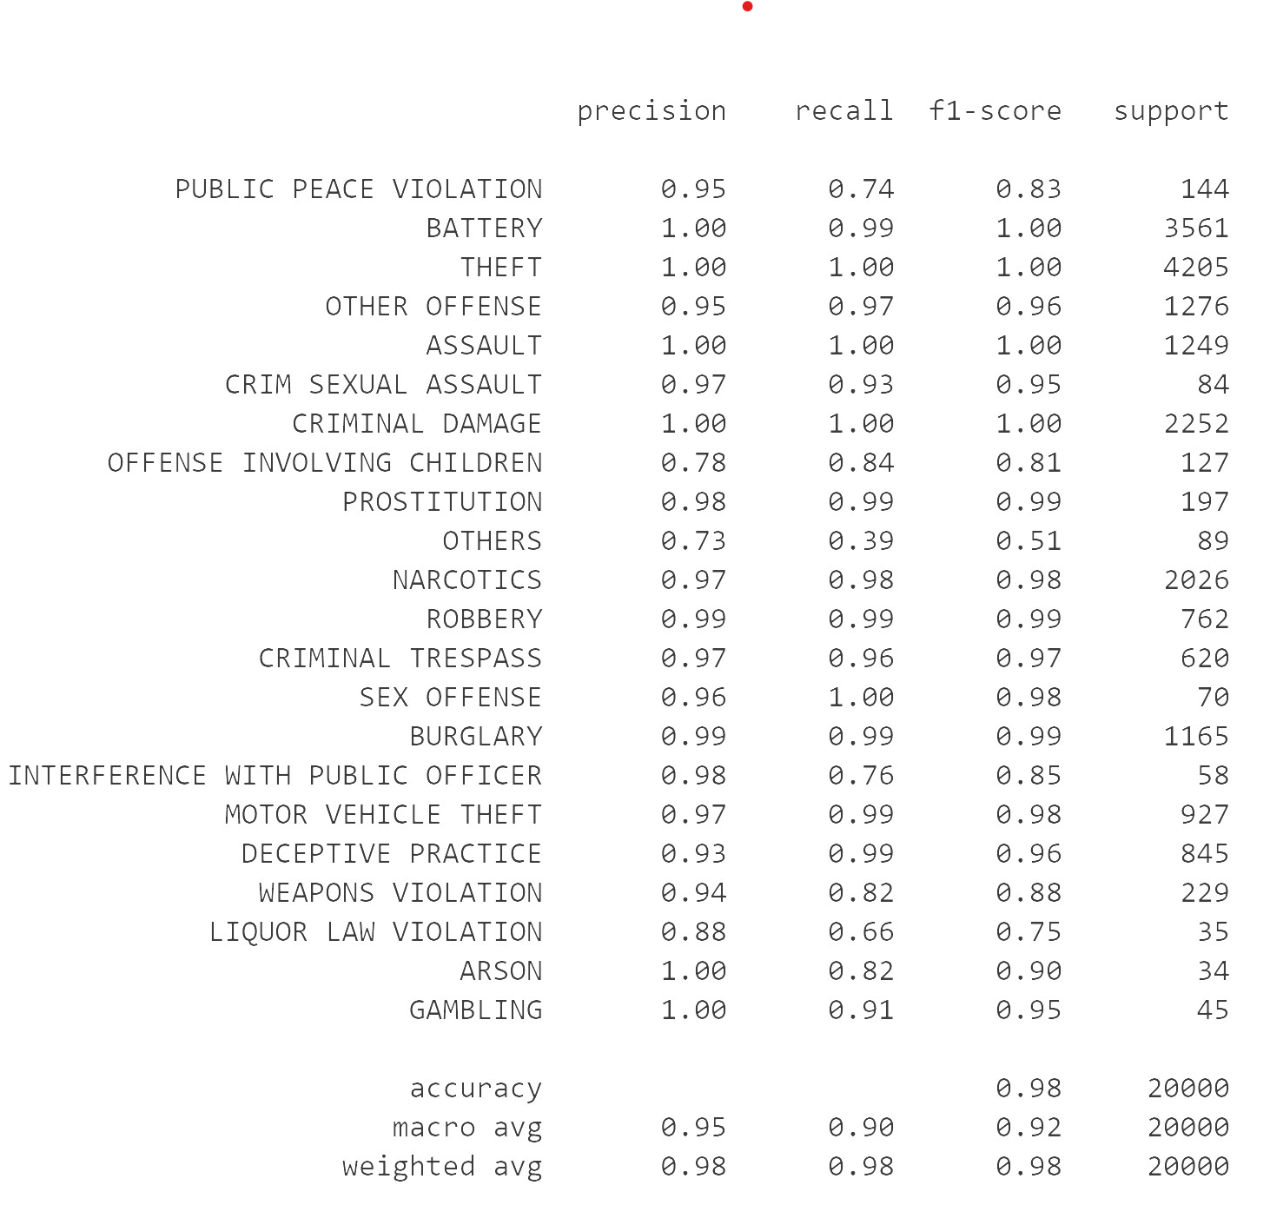
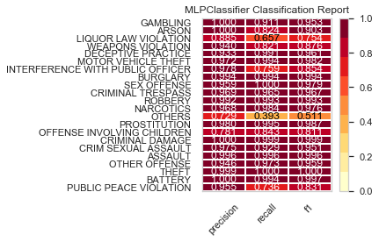
MLPClassifier

Slide 7
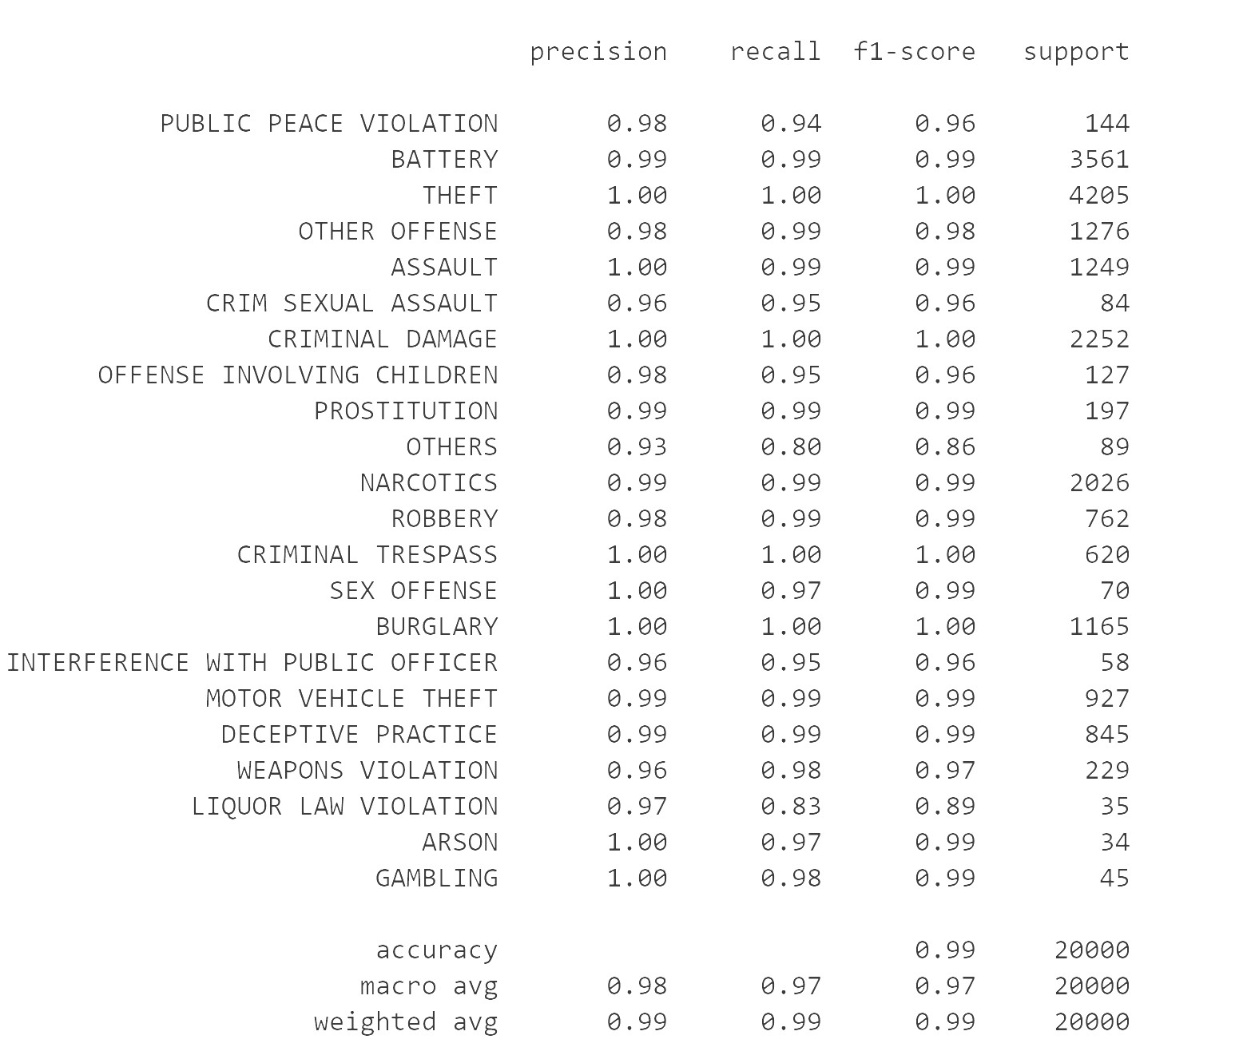
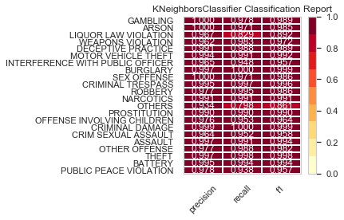
KNeighborsClassifier

Slide 8
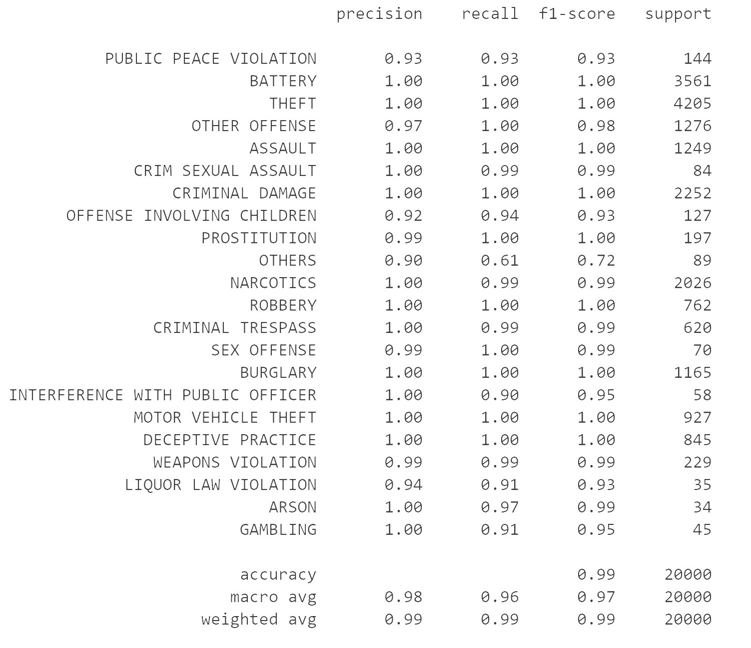
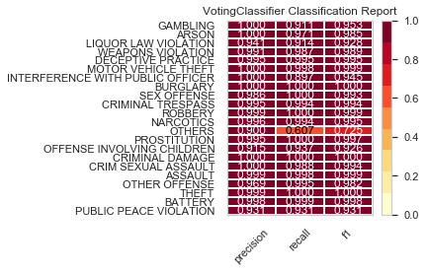
Final Model
By using ensemble voting classifier, after including all three models for better prediction and the results were like this

Slide 9
Conclusion
All three models were working well in predicting the crime type based on other features of that crime even though RandomForestClassifier is best among them
By using Voting Classifier we should get best results as it ensembles all three models to get better predictions. But I got better results by using RandomForestClassifier alone [I think it’s because of the sample size that I am using]

Slide 10

Thank You & Stay Safe

